Slide 1
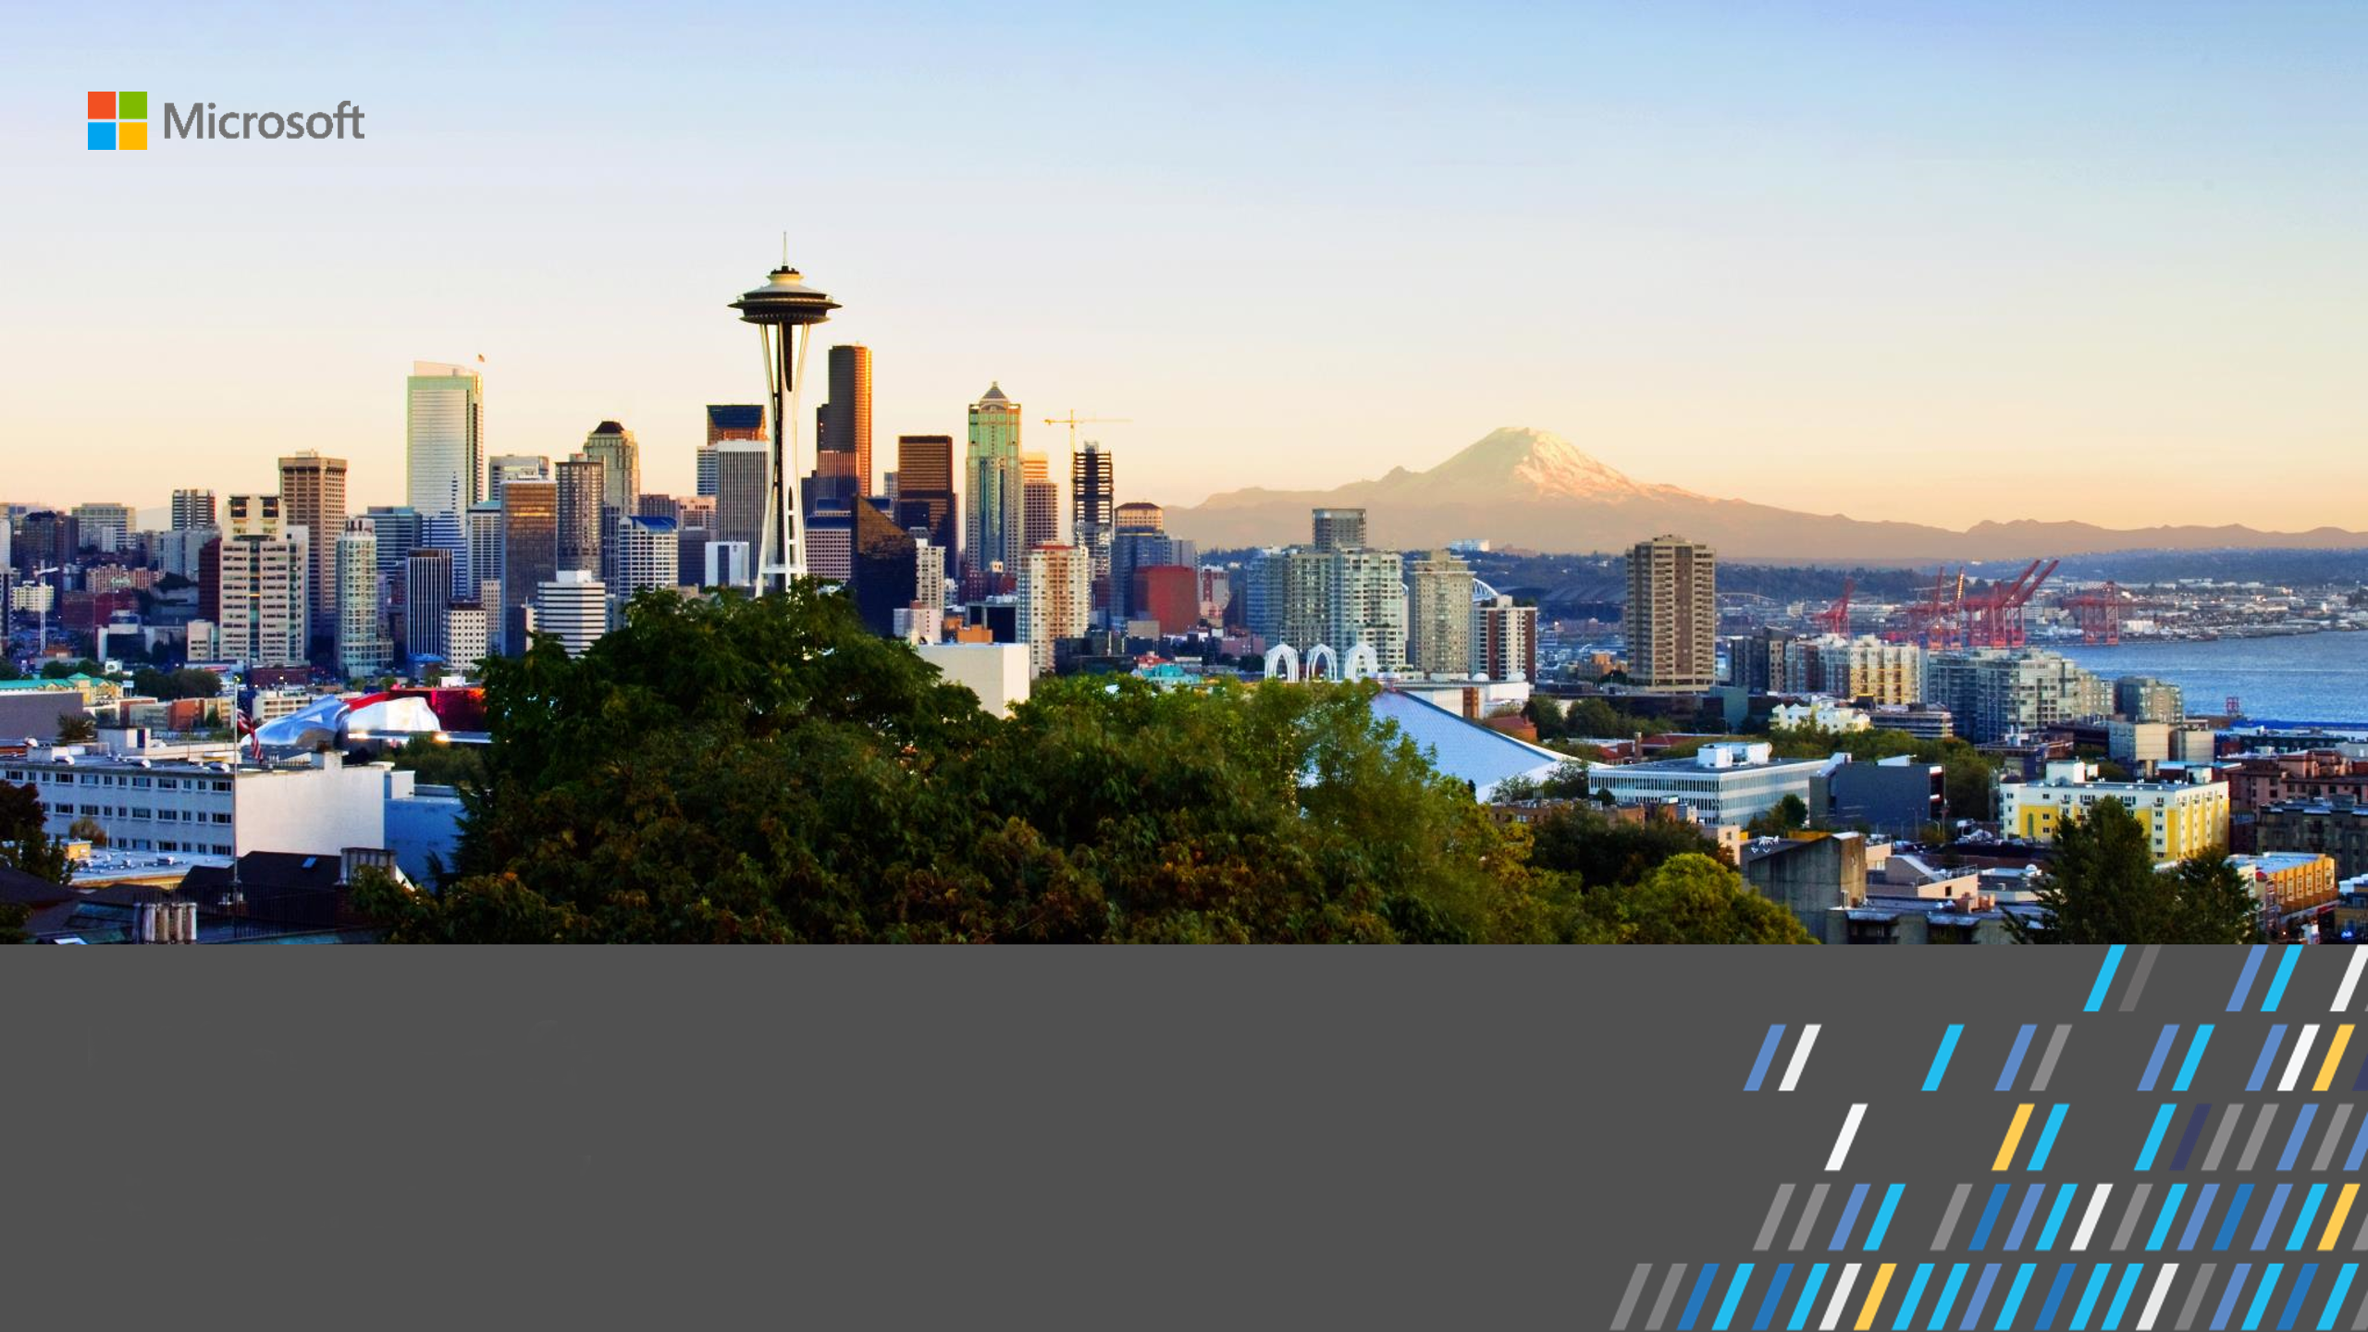
Dan Grecoe
Microsoft Artificial Intelligence Lab
Cambridge, MA

Slide 2
What’s it like?
Lots and lots of meetings….
Lots and lots of coding….
Some really fun travel…

Slide 3
What do you do?
Code in several different languages, mostly Python and C#, but there are others as well.
Work with the product teams that are building Microsoft Azure, the cloud platform, to create real world solutions that stress their products.
Work with real world customers to solve real world problems using artificial intelligence.

Slide 4
Formula One – Tyre Management
Tens of thousands of sensors at millisecond speed.
Car collects ~150GB of data per hour.
Tyres are hi degradation based on FIA rules.

Slide 5
Rolls Royce – Predictive Maintenance
Hundreds of sensors in jet engines.
Requires constant maintenance and parts replacements.
Imminent part failures can be detected with data.
Reduce aircraft downtime with predictions.

Slide 6
Teach Others
Work with teams inside and outside of Microsoft to evangelize solution architectures.
Talk at conferences
Help students with a path into technology.

Slide 7
Questions?

